Slide 1









My Algebra - Quadratics Interactive Notebook
$$×$$
$$\frac{1}{2}$$
$$÷$$
$$+$$
$$−$$
$$\frac{3}{5}$$
$$7$$
Name
Class
Teacher
Term 2 Semester 1
$$5^{2}$$
$$\sqrt{9}$$

Slide 2
Contents
Glossary or Formula Page
Page
Date
Description
2

Slide 3
Tasks
24
7
30
Essential Question
Questions
Notes
Summary
6

Slide 4
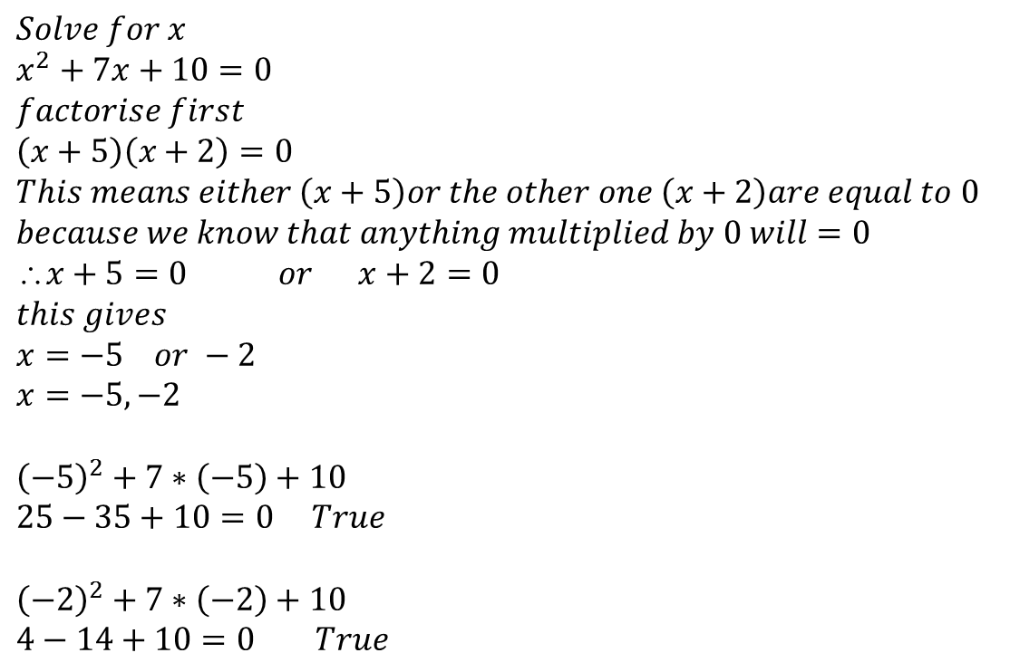
24
7
30
Date
Solving Quadratic Equations?
EQ – How does “= 0” help?
$$Solve for x \\ x^{2}+7x+10=0 \\ factorise first \\ \left(x+5\right)\left(x+2\right)=0 \\ This means either \left(x+5\right)or the other one \left(x+2\right)are equal to 0 \\ because we know that anything multiplied by 0 will=0 \\ x+5=0 or x+2=0 \\ this gives \\ x=−5 or −2 \\ x=−5,−2$$
$${\left(−5\right)}^{2}+7∗\left(−5\right)+10 \\ 25−35+10=0 True$$ $${\left(−2\right)}^{2}+7∗\left(−2\right)+10 \\ 4−14+10=0 True$$
Lets make our equation = 0!
We must have either of these two brackets equalling zero

Slide 5
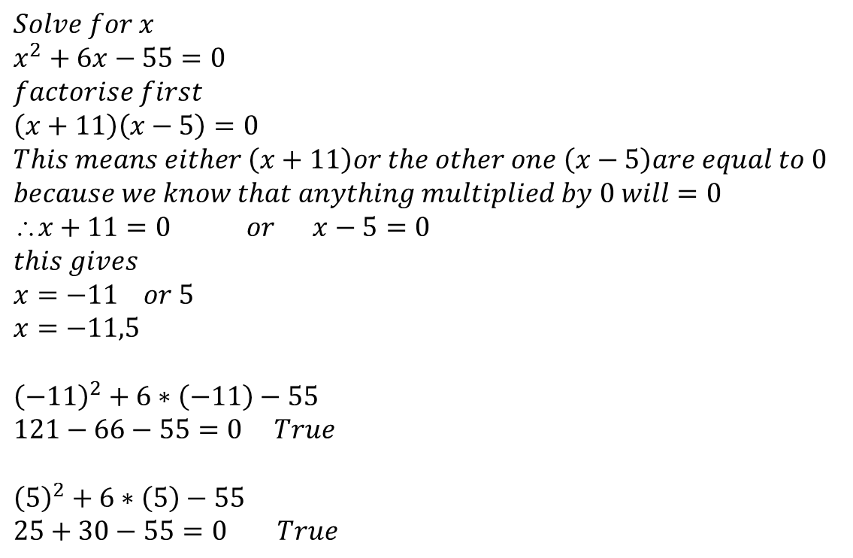
24
7
30
Date
Solving Quadratic Equations?
EQ – How does “= 0” help?
$$Solve for x \\ x^{2}+6x−55=0 \\ factorise first \\ \left(x+11\right)\left(x−5\right)=0 \\ This means either \left(x+11\right)or the other one \left(x−5\right)are equal to 0 \\ because we know that anything multiplied by 0 will=0 \\ x+11=0 or x−5=0 \\ this gives \\ x=−11 or 5 \\ x=−11,5$$
$${\left(−11\right)}^{2}+6∗\left(−11\right)−55 \\ 121−66−55=0 True$$ $${\left(5\right)}^{2}+6∗\left(5\right)−55 \\ 25+30−55=0 True$$
Lets make our equation = 0!

Slide 6
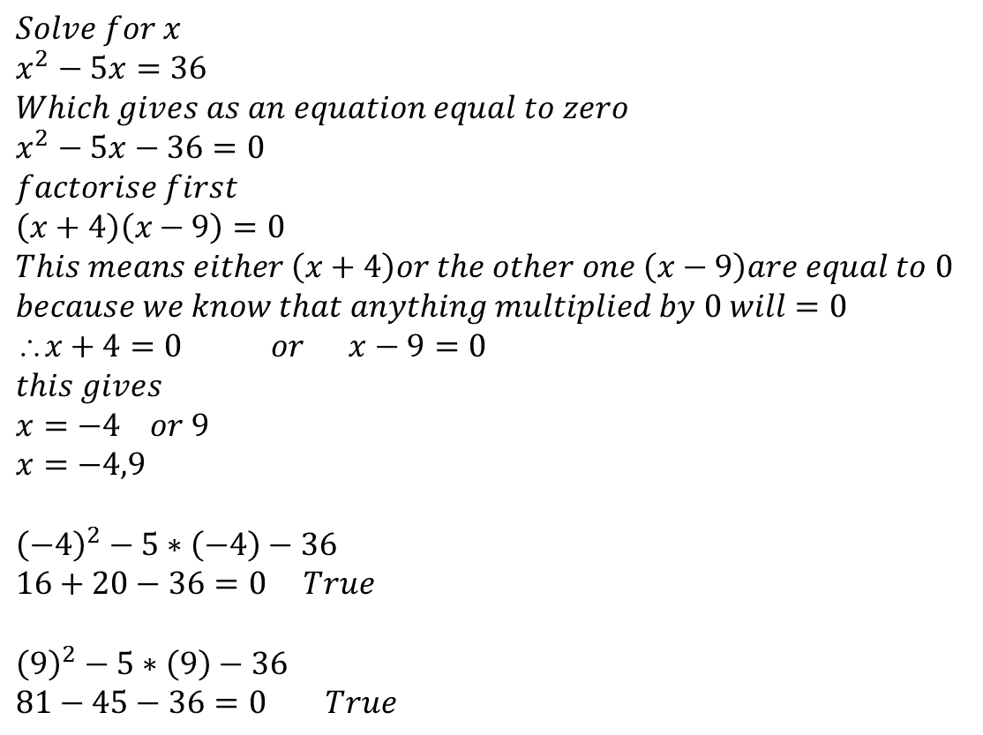
24
7
30
Date
Solving Quadratic Equations?
EQ – How does “= 0” help?
$$Solve for x \\ x^{2}−5x=36 \\ Which gives as an equation equal to zero \\ x^{2}−5x−36=0 \\ factorise first \\ \left(x+4\right)\left(x−9\right)=0 \\ This means either \left(x+4\right)or the other one \left(x−9\right)are equal to 0 \\ because we know that anything multiplied by 0 will=0 \\ x+4=0 or x−9=0 \\ this gives \\ x=−4 or 9 \\ x=−4,9$$
$${\left(−4\right)}^{2}−5∗\left(−4\right)−36 \\ 16+20−36=0 True$$ $${\left(9\right)}^{2}−5∗\left(9\right)−36 \\ 81−45−36=0 True$$
Lets make our equation = 0!

Slide 7
Exercises
Exercise 6.10 from Dwyer
All to be done with a smile on your faces.

Slide 8
Notes Review
24, 7 ,30
Date
Title
Essential question
Notes complete
Notes complete with colour and diagrams
Questions completed
Contents page filed in
Formula page filled in

Slide 9
Homework
Review your notes and write a summary answering the essential question.

